Slide 1
DL Project: Visual QA - Coeus
Dennis Rotondi
Leonardo Lavalle
Patrizio Perugini
Deep Learning 2021/2022 course
Sapienza University of Rome
1834864
1838492
1844358

Slide 2
Table of contents
Patrizio
Design choices
Baseline
Leo
Intermediate
ViLT
Dennis
Experiments
Conclusions

Slide 3
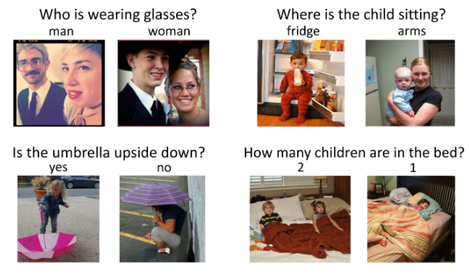
Visual Question Answering (VQA)
VQA is a very challenging task since it requires an understanding of vision, language and commonsense knowledge to answer a given question about an image.

Slide 4
Bird's-eye view of our approach
We decided to build different Deep Neural Network to tackle this problem:
our inputs are questions and images!
Deep Learning Model

Slide 5
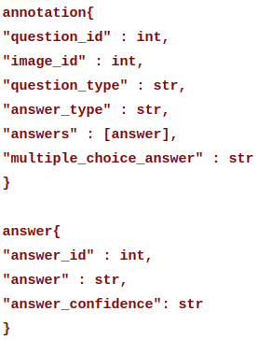
Dataset: VQA 2.0
As any Model worthy of the name, in order to accomplish good results we need data for training.
Hence we used Visual Q&A v2.0: a dataset containing open-ended questions about images.
It consists of :
265,016 images (COCO and abstract scenes)
At least 3 questions per image, stored using the JSON file format
10 ground truth answers per question
3 plausible (but likely incorrect) answers per question.

Slide 6
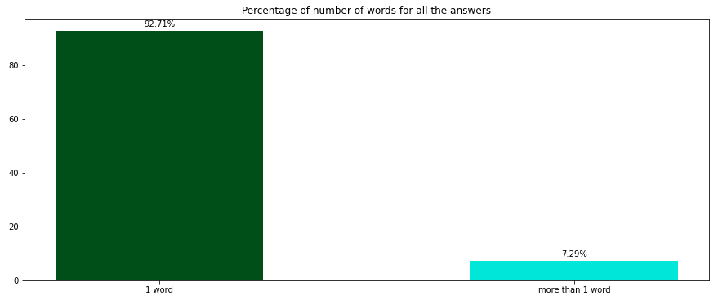
Statistics on the dataset
First of all we’ve performed statistical analysis on the dataset to make some design choices.
The most important are:
count of the answers with 1 word:
since SOTA for VQA is ~80% focusing only on 1-word answer is a reasonable approximation!

Slide 7
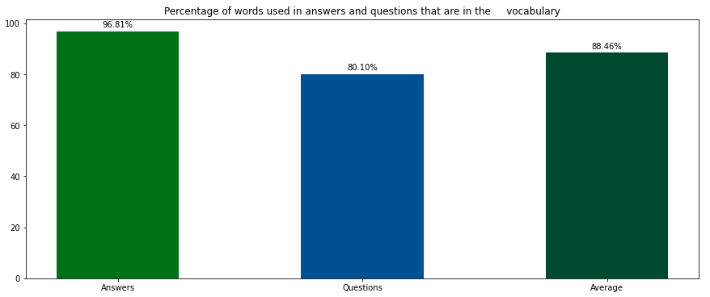
Statistics on the dataset
how many words our vocabulary (collection of “significant” words) cover in “Questions” and “Answers”:
since ~97% of the answers words are in a 1000 dimensional vocab this is a perfect choice.
We miss ~20% of questions’ words but we’ll see later that in our most advanced model we “drop” the questions’ vocab.
Notes:
“drop” because bert has its internal token vocabulary

Slide 8
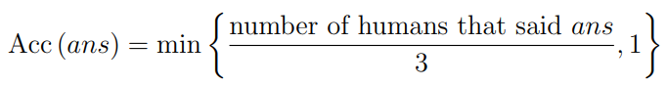
Hardware limits and Evaluation
Due to limited hardware we decided to train our model with only a subset of VQA 2.0 (10000 samples for train and 1000 for validation).
We have also been prevented to train all the models parameters and as a result we only selected (unfreezed) the most effective layers according to recent research.
The evaluation for all our models has been performed according to the metric:
clearly : even if we’ve trained our model only on 1-word answers, we evaluated it also using samples that require more than 1-word to be answered, this allowed us to discover nice properties that we’ll discuss later.
Notes:
“drop” because bert has its internal token vocabulary ..at least 3 -> correct

Slide 9
Solution development
Baseline
ViLT
LSTM+VGG
BERT+ViT
Intermediate
LSTM + ViT

Slide 10
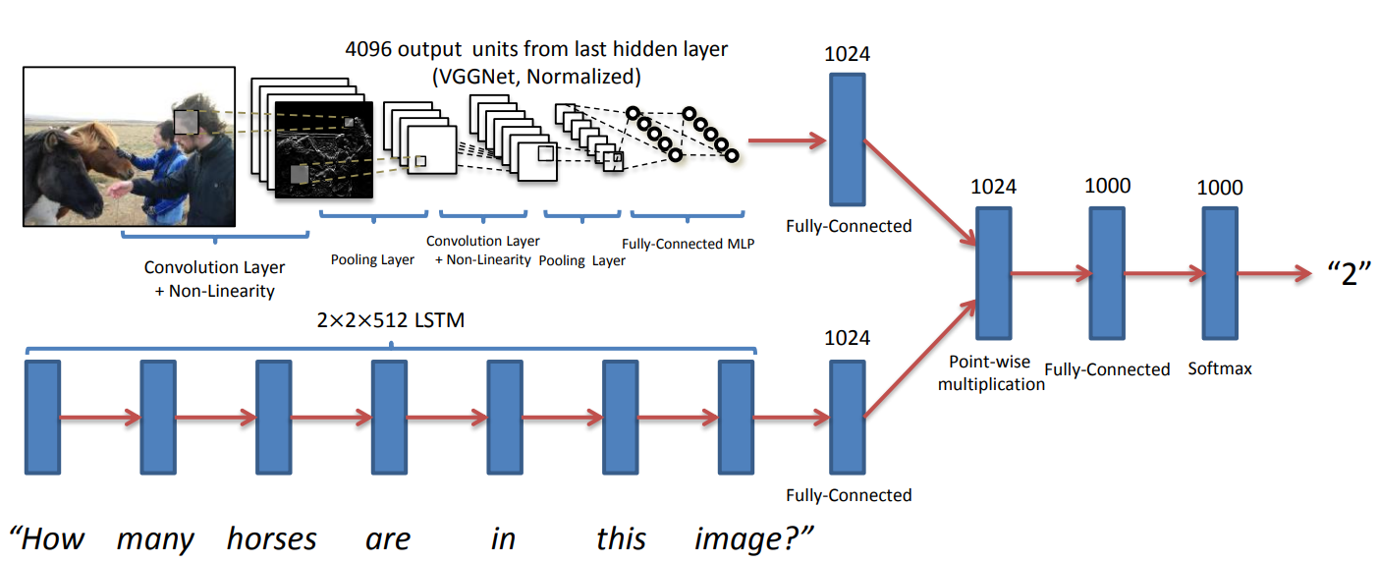
Baseline: Deeper LSTM Q (2015)
The model consists in 2 different channels: an image channel and a question channel.
Question channel: This channel provides an embedding for the question. LSTM with two hidden layers. One last FC layer is built on top to embed 2048-dim to 1024-dim.
Image channel: This channel provides an embedding for the image. In this part we used a VGG16. One last FC layer is built on top so to obtain an output 1024-dim.
Element wise multiplication of the two channels so to obtain a single embedding. This is then feed to a FC layer to predict the final answer.
Notes:
we are not using a pre-trained embedding for the words (like GLOVE or Word2Vec) but starting with a random initialization and we didn’t investigate further since the results where not that good (word emb dim = 300).
h1,c1..h2,c2 (2* num_layers)->4 * hidden_dim -> 4*512 = 2048….”late fusion” + softmax

Slide 11
Baseline: Conclusions
Using VGG, the model is not able to correctly learn specific features in an image (for instance to count objects), but it is only able in some cases to answer easy questions which would require a yes/no answer.
This subproblem can be seen as a classification task that our model is able to solve.
We also tried to use a Bi-LSTM to attain better performances, but we got the same training trend.
The bottleneck of our network is the Vision Model (VGG).
model | yes/no | other | number | total
w/LSTM | 0.6 | 0.0078 | 0.0027 | 0.254
w/Bi-LSTM | 0.63 | 0.0086 | 0.0027 | 0.265

Slide 12
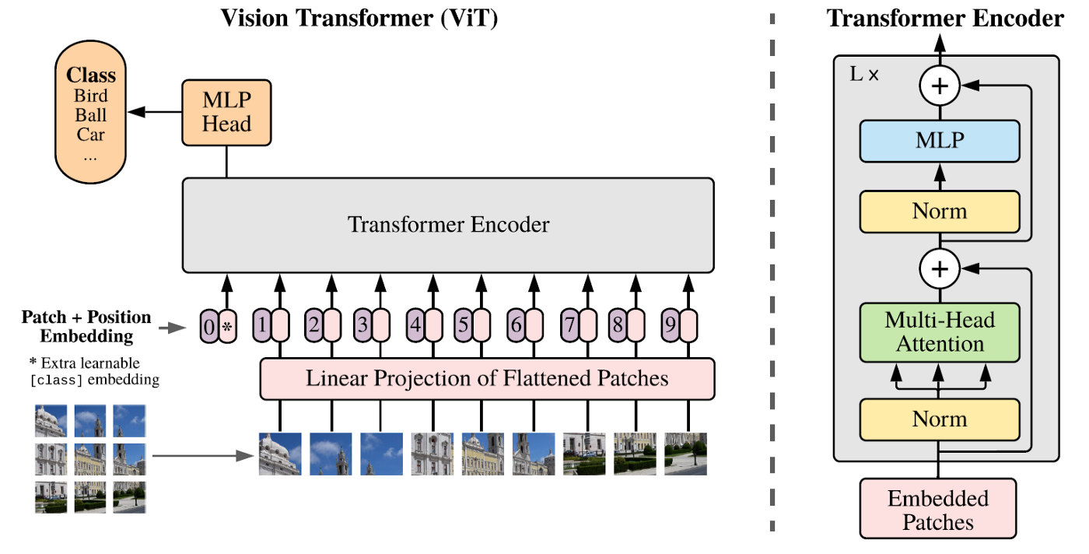
Intermediate: Vision Transformers (ViT) to the aid
Replace our VGG16 with a ViT: we used "google/vit-base-patch32-384" which takes as input images of size 384 and splits them in patches of size 32 for which it will compute the intra-attention mechanism. The output, that is the mean of the last hidden layer of ViT, is then concatenated to the language embedding generated by the LSTM.
patch_size (32) — The size of each patch.
hidden_size (768) — Dimensionality of the encoder layers.
num_hidden_layers (12) — Number of hidden layers in the Transformer encoder.
num_attention_heads (12) — Number of attention heads for each attention layer in the Transformer encoder.
ViT consists of stacked blocks that include a multiheaded self-attention (MSA) layer and an MLP layer. The position of layer normalization (LN) in ViT is the only difference from BERT.
But the Transformer doesn't have any clue about questions before "inference" time.
It doesn’t implement inter-attention :(

Slide 13
Intermediate: Conclusions
model | yes/no | other | number | total
w/ViT | 0.634 | 0.018 | 0.0 | 0.270
As expected the results are slightly better then the one obtained in the baseline.
It is interesting to notice that with this patching approach the model rapidly overfits the training dataset (6 epochs) and therefore has a much higher score with respect to the baseline there, but once we evaluate the model using validation set, performances drop drastically, with an accuracy of 0% when there is need to count!
These results confirms our thesis about the lack of inter-attention : ViT doesn't really know in which region of the image focus the attention to answer.
How can improve this model by giving it the capability to pose attention on a given question regarding an image?

Slide 14
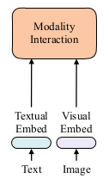
Vision and Language Transformer (ViLT)
“If we treat the image and language stream independently we cannot aim for the stars.”
For this reason we switched to an higher capacitive model that makes those two representation interact, in particular the Vision and Language Transformers.
We need inter-attention between images and language! Therefore as backbone we’ve used the ViLT model which exploits BERT, ViT and a Cross Modality Encoder, a final MLP will answer.
ViLT can reason on different patches of the image and point the correct attention to the meaningful features that allows to answer correctly by a Modality Interaction.
We used as pre-trained model "dandelin/vilt-b32-finetuned-vqa" from Hugging Face which has been pretrained on a VQA task and huge amount of data. Then, due to our hardware limits and different studies, we decided to fine-tune only the last 2 embedding layers!
Notes:
multiheaded self-attention (MSA) layer and an MLP layer

Slide 15
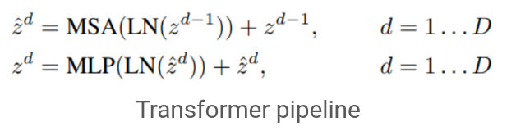
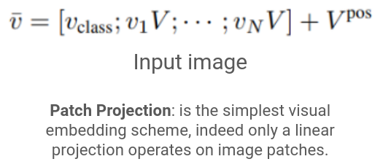
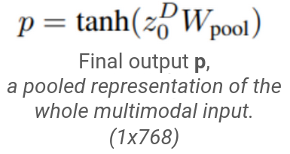
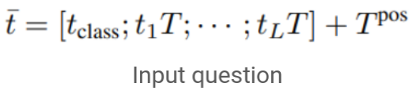
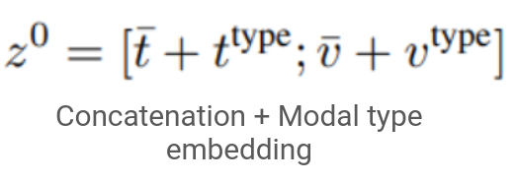
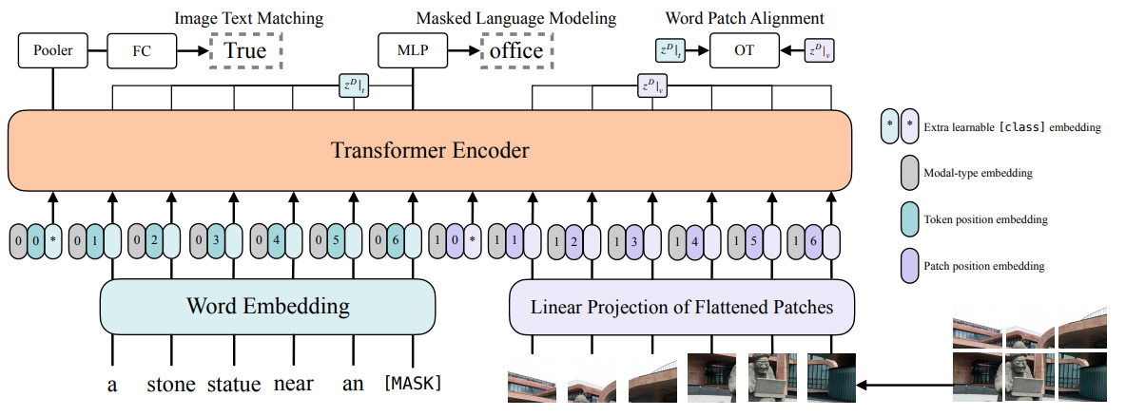
ViLT: Architecture
The pretraining-tasks to which the model owes
its strength and that make it possible to
implicitly learn the cross-attention are:
D = Depth = 12; patch_size = 32; hidden_dim=768

Slide 16
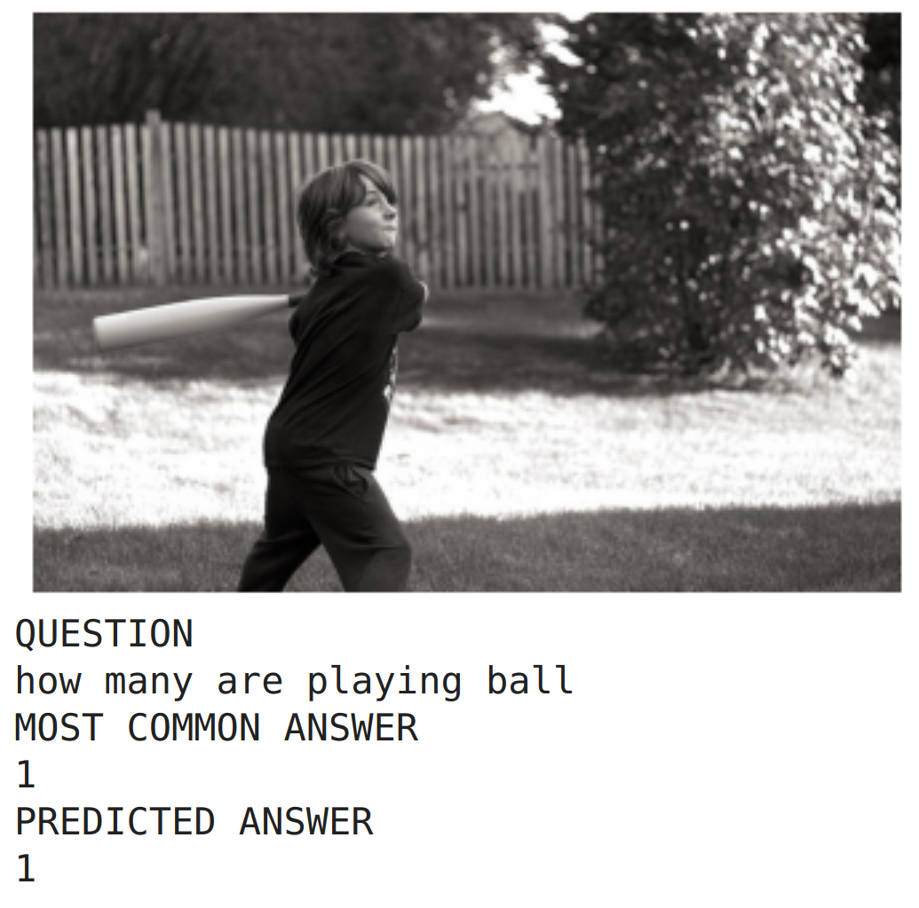
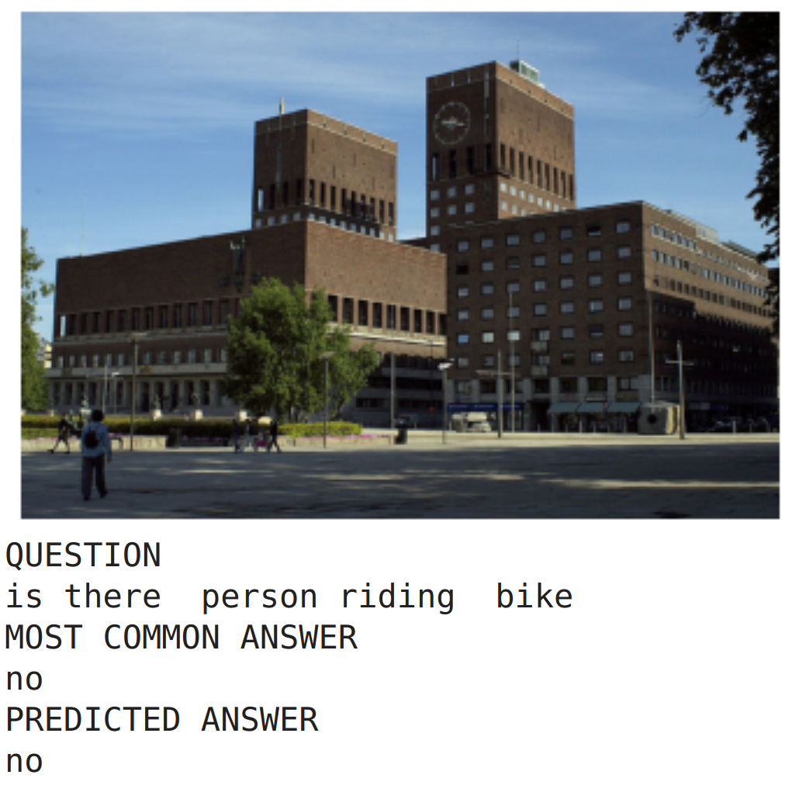
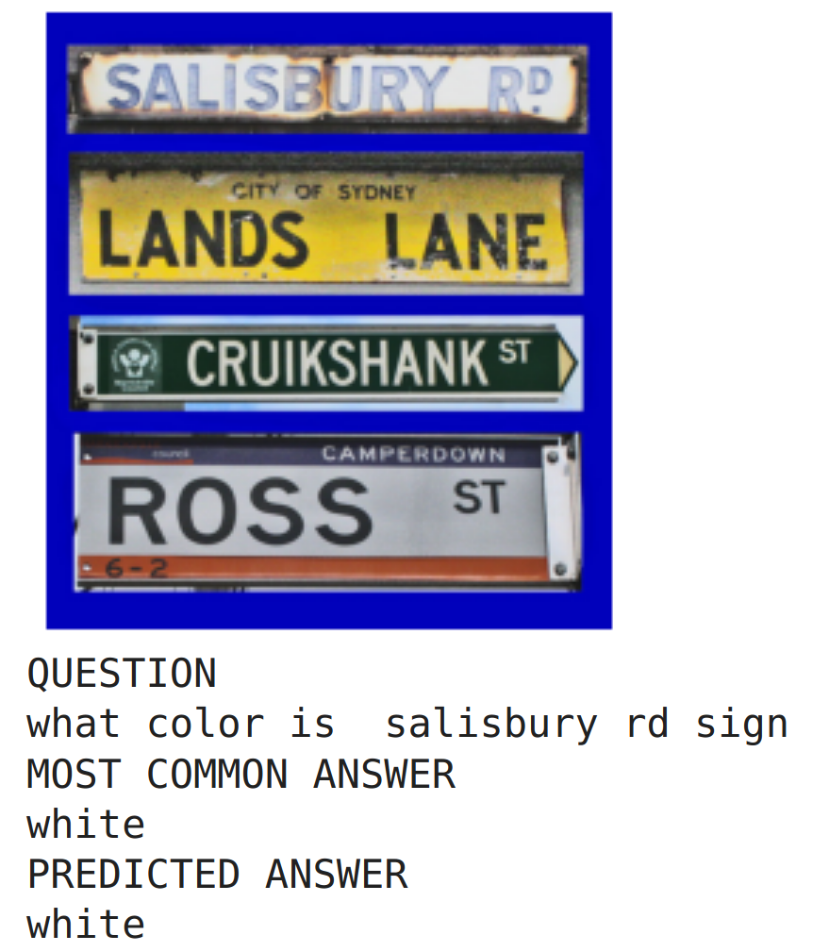
Predictions on the validation dataset

Slide 17
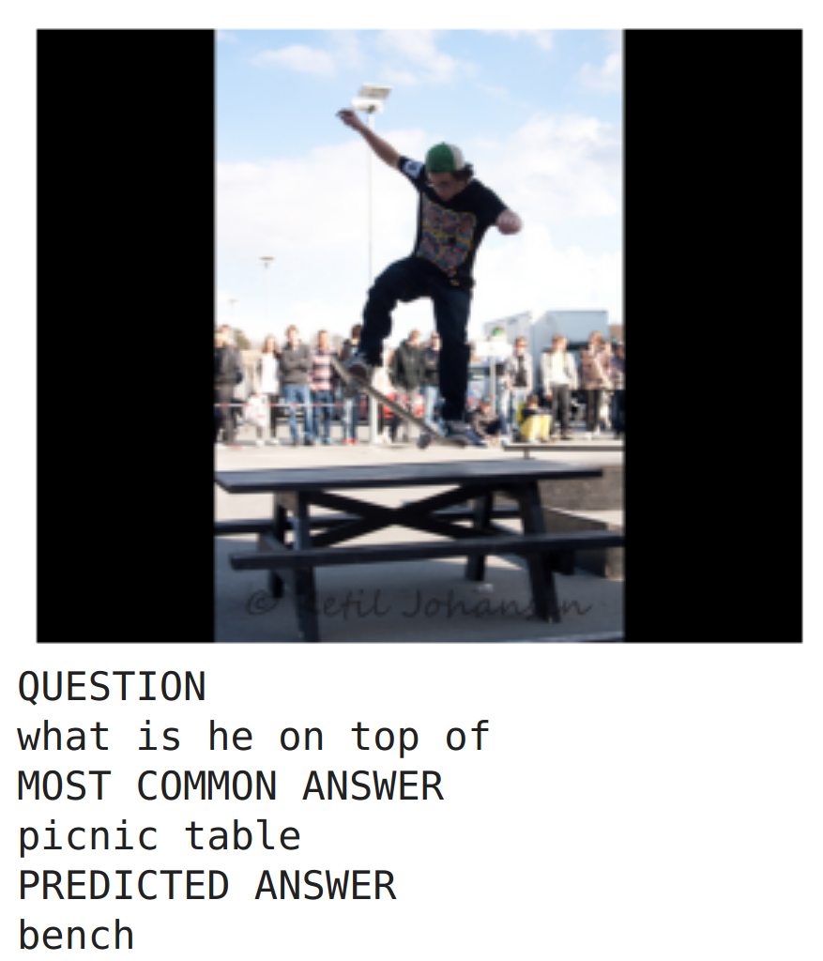
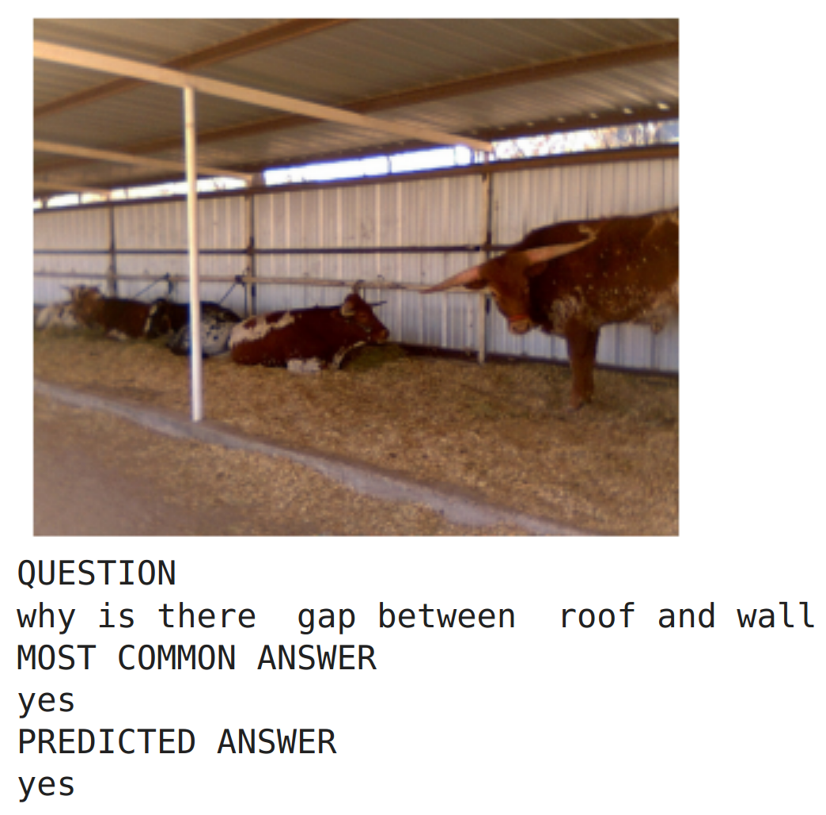
Predictions on the validation dataset

Slide 18
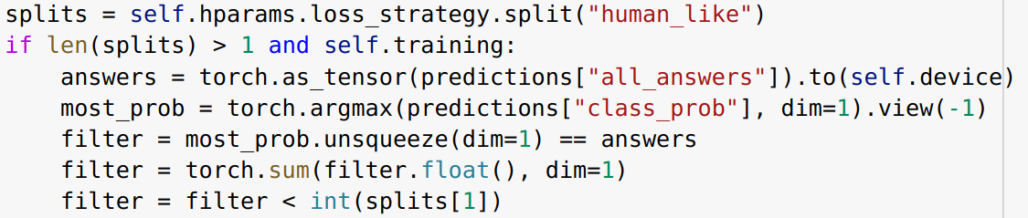
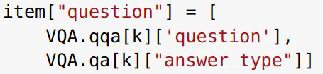
Experiments
Top-k gives an information regarding the number of final possible answers from which we draw according to their probability (top k = 1 it’s just the typical argmax approach)
Embedding has the two options “simple" and “with type", in the latter case also the type of the question is used to help the network in the prediction.
Loss can be either “simple" or “human like". In human like case the idea is to accept a prediction if it's present in the dataset answer pool.
OUR NOVELTIES
Notes:
context question embedding of BERT, often used in task like SRL and in particular shin lin paper. Once we fixed the other hparams we decided to do other experiments with different techniques

Slide 19
Final Results
yes/no 412; other 465; number 123
experiment | top k | embedding | loss | yes/no | other | number | final
1 | top 1 | simple | simple | 92.5% | 50.0% | 47.1% | 67.2%
2 | top 1 | with_type | simple | 92.3% | 48.2% | 58.8% | 67.7%
3 | top 1 | simple | human_like1 | 90.0% | 47.2% | 45.2% | 64.6%
4 | top 1 | simple | human_like2 | 9o.4% | 45.9% | 52.5% | 65.1%
5 | top 1 | with_type | human_like1 | 90.6% | 50.4% | 52.3% | 67.2%
6 | top 5 | simple | simple | 89.7% | 42.4% | 52.3% | 63.2%
7 | top 5 | with_type | human_like1 | 85.2% | 42.2% | 42.8% | 60.0%

Slide 20
Final Results: comments
The first experiment uses the standard methodology and will be used to compare the other results.
The second experiment confirms our intuitions: by giving also the context we are able to improve the network performances. This is because we are leading the model to filter between all the possible answers and focusing its attention to those features that are commonly required to infer the output.
Human-like experiments didn't bring astonishing results, still this is a technique that strongly reduce overfitting since it stops the propagation of the gradients for those answers' samples which are plausible because given as a reply by a human (1 or 2 times depending on the chosen loss strategy). With a larger training set maybe we would have gotten better results.
Top k prediction strategy lead to the worst results. In our opinion this strategy is really helpful when the model is slightly confused about the answer as may happen in the counting task. Indeed from the table we can see that wrt experiment 1, experiment 6 has an improvement of 6.2% in the number prediction but worsen in the others.

Slide 21
Conclusions
ViLT is very simple, yet very powerful for this complex task!
Notwithstanding the limited resources we have been able to got what only few years ago was much more than SOTA with our model and techniques.
We might as well have modified and used different loss strategies. For example, we could also have considered the confidence of the responses in the training set or we could have exploited the distribution of all 10 human responses in the cross-entropy function: the possibilities are vast.
Another interesting idea could be to let a vision + language model extract the interpretation of the image it is seeing and then feed the VQA model with this generated description plus the image regarding the question. The two text description could be processed by some MSA layers to “search” the image only for those elements that have not been highlighted from the caption.
We applied our ideas without touching the model because we have thought that a sensible change on the architecture need a lot of computational power, still if we had it we could have tried to use linear projections of patches with different sizes so to try improve the classification task leading the model with larger patches;

Slide 22
Thank you for the attention!
Dennis Rotondi
Leonardo Lavalle
Patrizio Perugini
Deep Learning 2021/2022 course
Sapienza University of Rome
1834864
1838492
1844358

